Slide 1
Alamo AFcEA Education Foundation

Slide 2
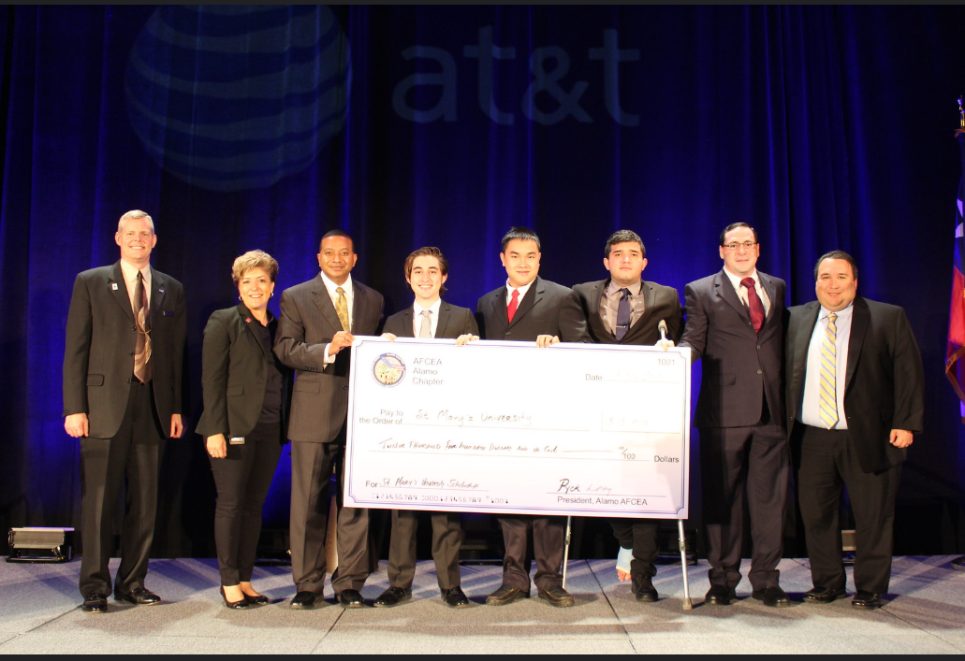
Scholarships and Grants
In past 10 years, S&G grown from $40 to ~200k per year
Started focused on Scholarships to local Universities to grow a STEM pipeline
Established MOUs to help manage our Scholarships –provide Individual Support
Targeting broader opportunities to grow STEM through out the community – Refocus on Return on Investment
Tools, Military Education Grants, Cyber patriot, First Robotics, Ghost Academy, and Drones in Elementary Schools
Started to tracking ROI and refocused spending on what we could quantify –Teachers 1:32
S&G Themes per Year
Title I Schools, Teachers in STEM and Girls in STEM

Slide 3
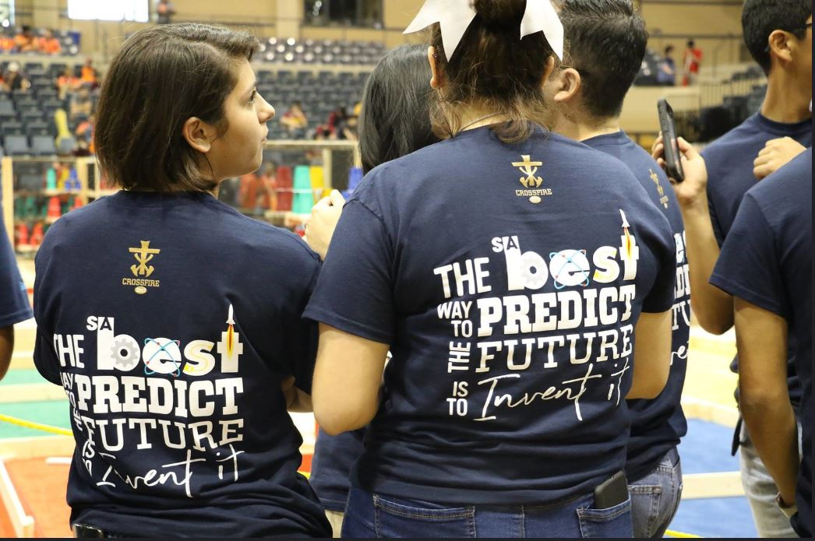
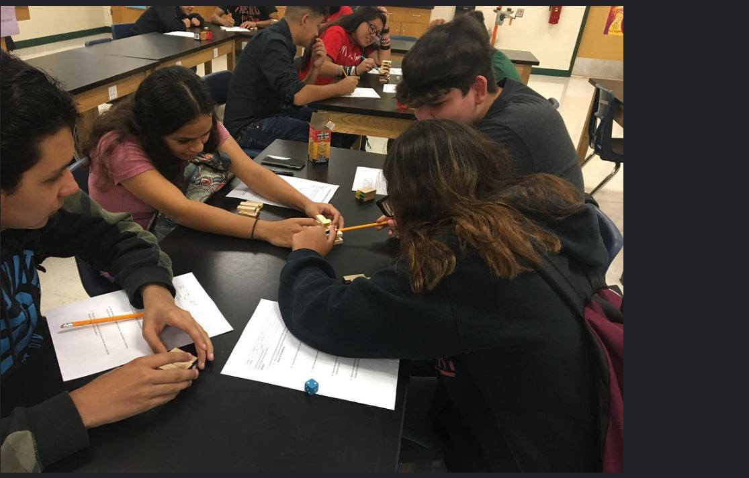
Scholarship and Grants
Restructured our Scholarship and Grants program in to a Education Foundation 501 c (3)
Growth of the Chapter allowed for efforts to restructure
Chapter prioritizes donating as one of our highest priorities
Seeking opportunities to give back to the Community and support STEM growth and Wounded Warrior care
Chapter working to emphasize partnerships/collaboration to build longer term, sustainable program that leverages resources in the city, chambers and industry

Slide 4
Questions?

